Slide 1

Sensing conducted EMI in power lines for appliance disaggregation
Highlights: Overview of NILM, Past work, Conducted EMI as a unique/deterministic aspect
Manoj Gulati
Advisers: Dr. Amarjeet Singh and Dr. Shobha Sundar Ram
Meeting: Sidhant Gupta Ph.D CS UW

Slide 2
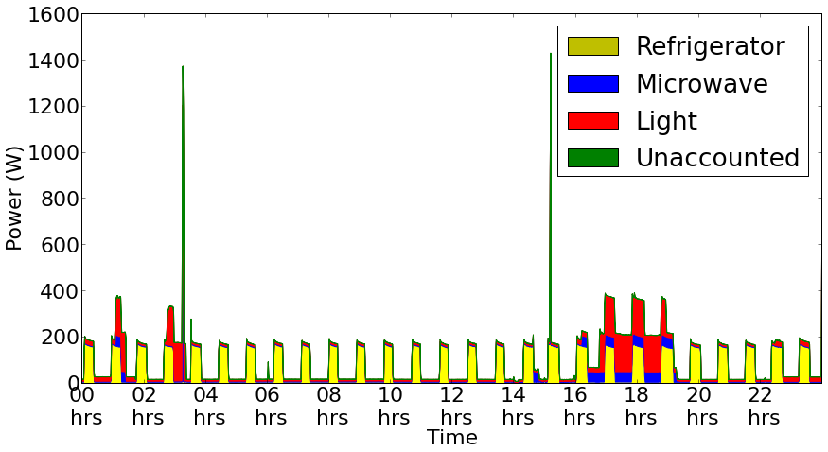
Overview of NILM
NILM: Non intrusive load monitoring is a process for analysing changes in voltage and current going in to a house and deducing what appliance's are used in the house as well as individual energy consumption.[A]
Source: Batra Nipun, Haimonti Dutta, and Amarjeet Singh. "Indic: Improved non-intrusive load monitoring using load division and calibration." Machine Learning and Applications (ICMLA), 2013 Twelfth International Conference on. IEEE. 2013.

Slide 3
Motivation
NILM has several proven applications for industries as well as for households some significant points taken from past literature in NILM applications are:
Automatic fault detection and diagnostics in power systems based on performance tracking[1,2,3,4,6]
Fault prediction in ship board equipment's[5,7,8]
Indoor activity sensing[9]
Indoor localization
Individual Energy apportionment

Slide 4
Conducted EMI
Conducted EMI is essentially high frequency disturbance being generated from high speed switching currents from SMPS. [D]
Due to higher efficiency and power regulation capabilities of SMPS there has been significant shift from linear power supplies towards SMPS.
As a matter of fact previous research in NILM fails on multistate and complex loads i.e. laptop due to reliance on state based models like HMM* which assumes finite state operation of appliances.[B]
Due to more and more adoption digitally controlled appliances driven by SMPS the low frequency disaggregation techniques are prone to failure. Need for frequency domain analysis of high frequency CE for NILM is proved to be promising by recent literature. [C]
*HMM: Hidden markov models

Slide 5
EM noise propagation
Resistive (or Galvanic) coupling
Noise signal propagates through electrical connections
‘Common impedance’ can be classified as galvanic coupling
Occurs due to sharing of current paths [1] [2]
Capacitive coupling
Electric fields form the main coupling path
Inductive coupling
High frequency switching currents in Inductors
Cause strong magnetic fields at high frequencies
Occurs quite often in SMPS
Wave coupling
Noise is transmitted via Electromagnetic wave
Come in to picture at high frequencies usually in GHz
[1] http://www.learnemc.com/tutorials/Common_Impedance_Coupling/conducted_coupling.html
[2] http://www.learnemc.com/tutorials/Current_Paths/Current_Paths.html

Slide 6
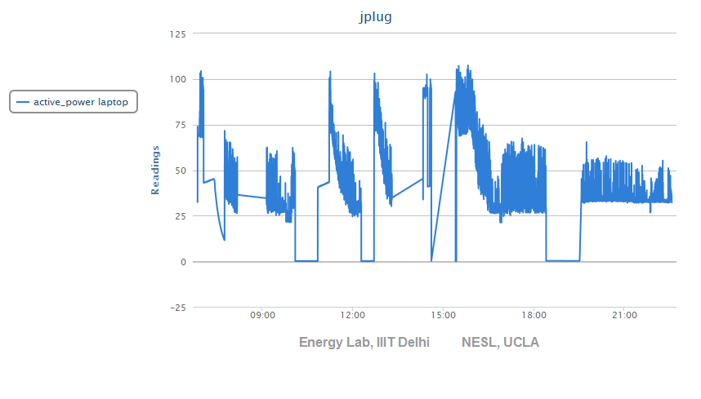
Power Trace from Laptop

Slide 7
Proposed work for sensing CE
To study unique and distinct features in conducted EMI generated by multiple electrical appliances.
Specific test cases:
Study impact of voltage fluctuations & building architecture on CE.
Study dissimilar features in CE during w/ and w/o load.
Study effect on CE of a single SMPS(EUT) for different loads.
Analyze features and unique aspects in CM CE and DM CE for different electrical loads.
Analyze response of EMI (constructive/destructive interference) w/o LISN.
Analyze low freq. disturbances due to different loads.
Try to differentiate among appliances with dual switching sections (i.e. PFC section and DC-DC convertor section).
*CE Conducted EMI *CM Common mode *DM Differential mode

Slide 8
Experimental Setup-1
High Voltage
Components
Line
Mains
Power Supply
High Pass Filter (Fc = ~31 KHz)
Flat Response 50KHz – 30Mhz
Attenuator
(To avoid risk to Signal Analyzer)
Spectrum Analyzer
Neutral
Equipment under Test (Known type of SMPS)
Test Load (LCD/Laptop)

Slide 9
Experimental Setup-2
High Voltage
Components
High Voltage
Components
Low Pass Filter (Fc = 60Hz)
To chop of HF disturbances
Line
Mains
Power
Supply
High Pass Filter (Fc = ~31 KHz)
Flat Response 50KHz – 30Mhz
Attenuator
(To avoid risk to Signal Analyzer)
Spectrum Analyzer
Neutral
Equipment under Test (Known type of SMPS)
Test Load (LCD/Laptop)

Slide 10
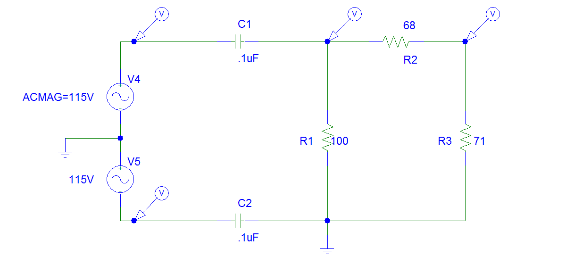
High pass filter (Ver1.1)

Slide 11
Proposed Setup-1 (To study HF disturbances)
High Voltage
Components
High Voltage
Components
Low Pass Filter (Fc = 60Hz)
To chop of HF disturbances
Line
High Speed ADC + MCU (Capable to push data to cloud)
Mains
Power
Supply
High Pass Filter (Fc = ~31 KHz)
Flat Response 50KHz – 30Mhz
Attenuator
Mains power supply provided to Building under test
Multiple combinations of SMPS and Non-SMPS loads
Neutral

Slide 12
Proposed Setup-2 (To study LF disturbances)
High Voltage
Components
High Voltage
Components
Low Pass Filter (Fc = 60Hz)
To chop of HF disturbances
Line
High Speed ADC + MCU (Capable to push data to cloud)
Mains
Power
Supply
Low Pass Filter (Fc = >50 KHz)
Flat Response
0 Hz - 50KHz
Attenuator
Mains power supply provided to Building under test
Multiple combinations of SMPS and Non-SMPS loads
Neutral

Slide 13
Power Supply Classification By SMPS Topologies
Topology | Applications | Power | Benefits | Negative aspects
Flyback | Cellphone chargers (<10W) Notebook adapters (<100W) CRT Power supplies (<150W) | <150W | Ease of implementation Well-Documented convertor. Operates on wide mains Large controller offer | High Peak currents Leakage inductance difficult to manage
Single switch forward | ATX power supplies (<250W) DC-DC convertors for telecom | <300W | Good cross regulation with coupled inductors. Good EMI signature. Low AC content, low conduction losses | Stress on power MOSFET. Difficult to operate on wide mains. Requires transformer reset. Duty cycle clamped to 50%
Two-Switch forward | ATX power supply (<500W) DC-DC convertor Telecom Servers(<500W) | 100-500W | Good cross regulation with coupled inductors. Good EMI signature. MOSFET stress clamped to Vin | Difficult to operate on wide mains. Requires transformer reset. Duty cycle clamped to 50% Requires high side drive.

Slide 14
Topology | Applications | Power | Benefits | Negative aspects
Half-Bridge | ATX power supply (<500W) DC-DC convertor Telecom Servers(<500W) | 100-500W | Good cross regulation with coupled inductors. Good EMI signature. MOSFET stress clamped to Vin. Duty cycle <100% | Difficult to operate on wide mains. Requires high side drive. Cannot easily work with current mode.
Half-Bridge LLC | Medical power supplies LCD or plasma TV | <500W | Excellent EMI signature Can work in no load. Smooth waveforms, zero voltage switching (ZVS) possible. | High side drive Large RMS current Narrow mains operation. Dangerous short circuit.
Full bridge | Server and mainframe power supplies. High power DC-DC convertors for telecom. | >500W | Good cross regulation with coupled inductors. Resonant operation via phase shift. Good EMI signature. MOSFET stress clamped to Vin. Duty cycle <100% | Difficult to operate on wide mains. Requires two high side drive circuits. Four MOSFETs to drive.
Push-Pull | DC-DC convertors | <200W | MOSFETs control is ground referenced Duty cycle <100% | Voltage stress of 2Vin Center-tapped primary.
Source: Appendix1C(Pg-93) Switched Mode power supplies by Christophe P. Basso

Slide 15
Current Status of Experiments
Prepared PCB for HPF ver1.1 going to test it on 08-2-2014 with Low amplitude High freq. signals to observe freq. response on Signal analyzer.
Second test will be with 230VAC in controlled environment, initially with DSO then with Signal analyzer.
Preparing NILM survey to figure out what all approaches are currently being used to disaggregate appliance level information/ appliance states.
Improving upon appliance classification list to motivate my current research problem.

Slide 16
DC-DC Convertor
Buck Convertor (Step down)
Boost Convertor (Step up)
Buck Boost Convertor (Step up/down)

Slide 17
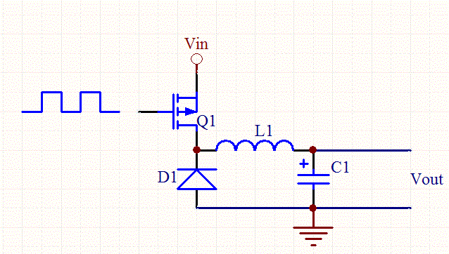
Simple Buck Regulator (Open-loop)
Image Courtesy:
http://www.daycounter.com/LabBook/BuckConverter/Buck-Converter-Equations.phtml

Slide 18
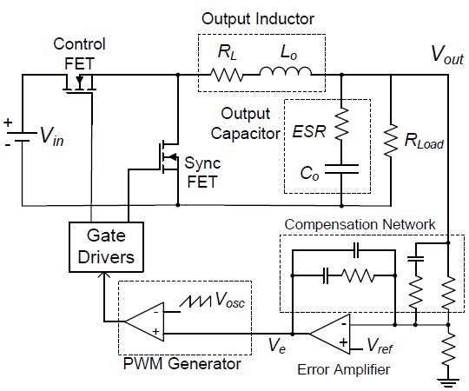
Buck Regulator (Closed-loop)
Image Courtesy:
AN: 1162 Compensator Design Procedure for Buck Converter with Voltage-Mode Error-Amplifier

Slide 19
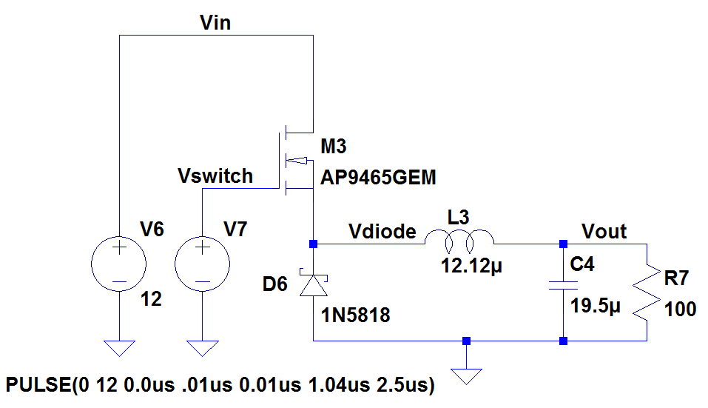
Buck Regulator

Slide 20
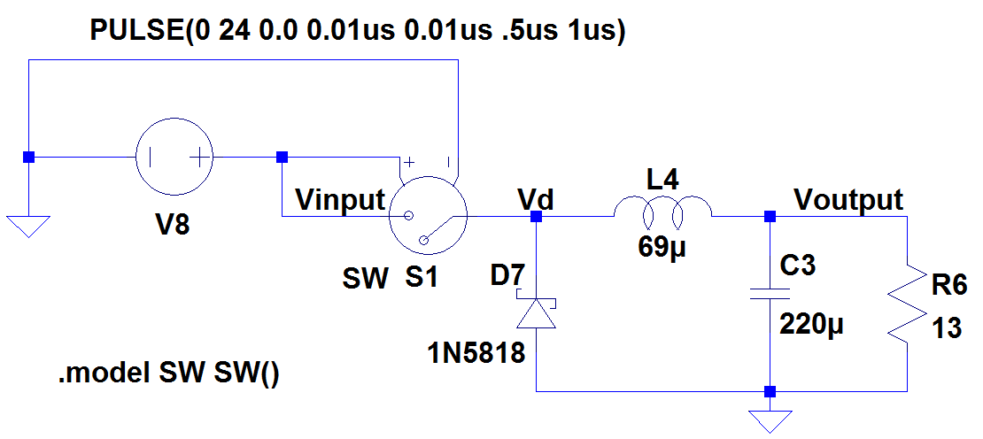
Simplified Buck Convertor

Slide 21
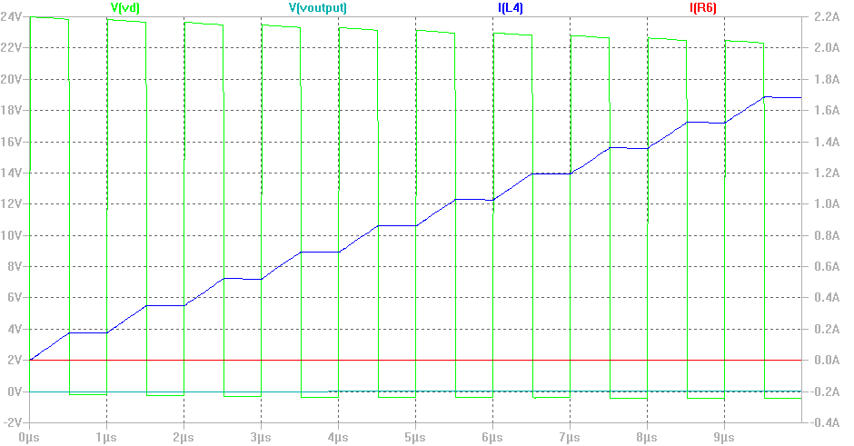
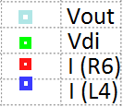
Transient Analysis

Slide 22
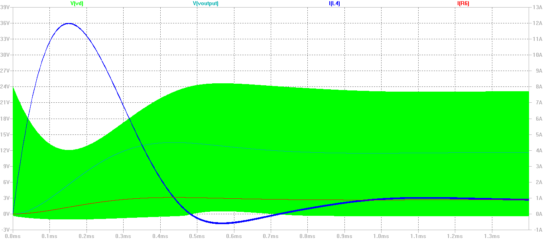
Steady State Analysis

Slide 23
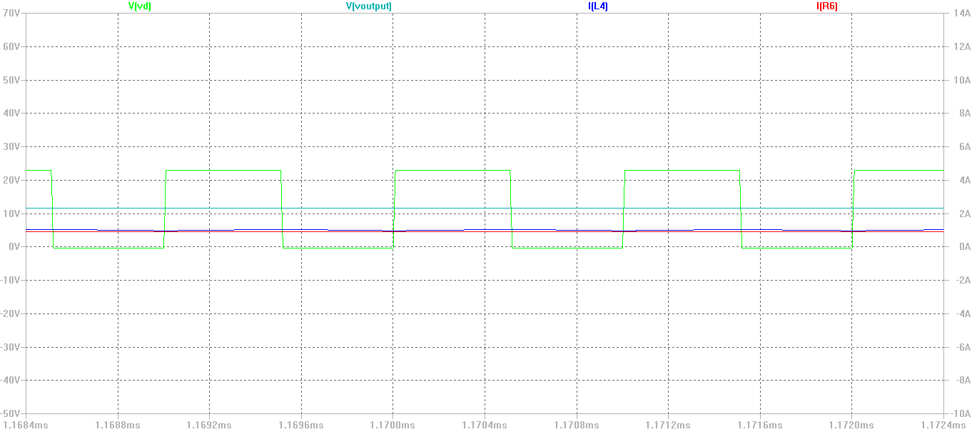
Steady State Analysis
After Zooming

Slide 24
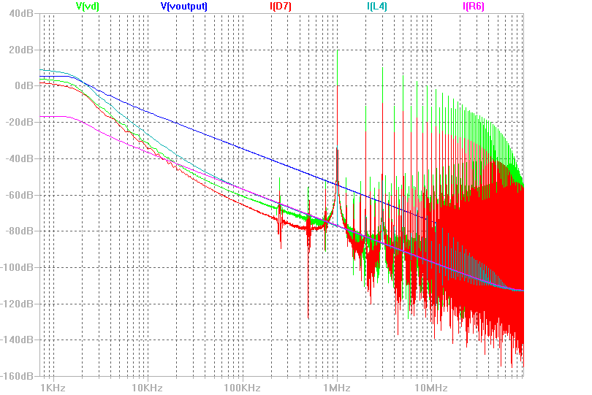
Frequency Domain Analysis

Slide 25
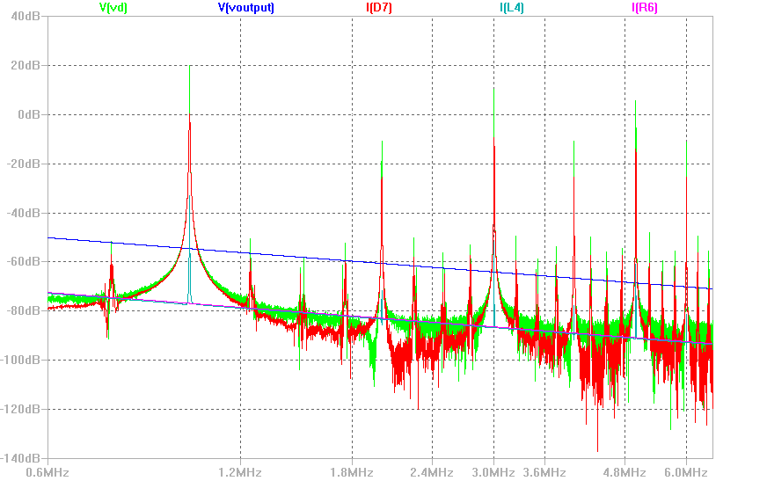
Frequency Domain Analysis
http://www.facstaff.bucknell.edu/mastascu/elessonshtml/Freq/Freq4Note11SquareWave.htm

Slide 26
References (NILM Applications)
Shaw, S.R., R.F. Lepard, S.B. Leeb, and C.R. Laughman, “A Power Quality Prediction System,” IEEE Transactions on Industrial Electronics, Volume 47, No.3, June 2000, pp. 511-517.
Shaw, S.R., D. Luo, L.K. Norford, S.B. Leeb, “Detection of HVAC Faults via Electrical Load Monitoring,” International Journal of HVAC&R Research, Volume 8, No. 1, January 2002, pp.13-40.
Lee, K.D., S.B. Leeb, L.K. Norford, P. Armstrong, J. Holloway and S.R. Shaw, “Estimation of Variable Speed Drive Power Consumption from Harmonic Content,” IEEE Transactions on Energy Conversion, Volume 20, No. 3, September 2005, pp. 566-574.
Armstrong, P.R. C.R. Laughman, S.B. Leeb, and L.K. Norford, “Detection of Rooftop Cooling Unit Faults Based on Electrical Measurements,” International Journal of HVAC&R Research, Volume 12, No. 1, January 2006, pp.151-176.
Mitchell, G.R., R.W. Cox, J. Paris, S.B. Leeb, “Shipboard Fluid System Diagnostic Indicators Using Non-Intrusive Load,” Naval Engineer’s Journal, Volume 119, No. 1, November, 2007.
Shaw, S.R., S.B. Leeb, L.K. Norford, R.W. Cox, “Nonintrusive Load Monitoringand Diagnostics in Power Systems,” IEEE Transactions on Instrumentation and Measurement, Volume 57, No. 7, July 2008, pp. 1445-1454.

Slide 27
References (NILM Applications)
7. Proper, E., Cox, R., Leeb, S., Douglas, K., Paris, J., Wichakool, W., Foulks, L., Jones, R., Branch, P., Fuller, A., Leghorn, J., Elkins, G., “Field Demonstration of a Real-Time Non-Intrusive Monitoring System for Condition-Based Maintenance,” Electric Ship Design Symposium, National Harbor, Maryland, February 2009.
8. Paris, J., Remscrim, Z., Douglas, K., Leeb, S., et. al., “Scalability of NonIntrusive Load Monitoring for Shipboard Applications,” ASNE Day 2009, National Harbor, Maryland, April, 2009.
9. Cho, Hyun Sang, Tatsuya Yamazaki, and Minsoo Hahn. "AERO: extraction of user's activities from electric power consumption data." Consumer Electronics, IEEE Transactions on 56.3 (2010): 2011-2018.

Slide 28
References (NILM)
Hart, George William. "Nonintrusive appliance load monitoring." Proceedings of the IEEE 80.12 (1992): 1870-1891.
Barker, Sean, et al. "Empirical characterization and modelling of electrical loads in smart homes." Green Computing Conference (IGCC), 2013 International. IEEE, 2013.
Gupta, Sidhant, Matthew S. Reynolds, and Shwetak N. Patel. "ElectriSense: single-point sensing using EMI for electrical event detection and classification in the home." Proceedings of the 12th ACM international conference on Ubiquitous computing. ACM, 2010.
Antonini, Giulio, Saverio Cristina, and Antonio Orlandi. "EMC characterization of SMPS devices: circuit and radiated emissions model." Electromagnetic Compatibility, IEEE Transactions on 38.3 (1996): 300-309.

Slide 29
Industry Initiatives
http://datadrivenbuilding.org/

